Slide 1


Region 14
PMI: Beyond the Chapter
Jim Devine, PMP Joe Paschall, PgMP, PMP
PMI Region 14 Mentor PMI Region 14 Mentor (Shadow)

Slide 2
Agenda
Introduction
PMI Past, Present, Future
PMI Structure Supporting Chapters
Opportunities Beyond the Chapter
Upcoming Events
Q&A

Slide 3

Introduction
Notes:
3
3
Let me start by telling you all a little about myself. I will start with my involvement with PMI.

Slide 4
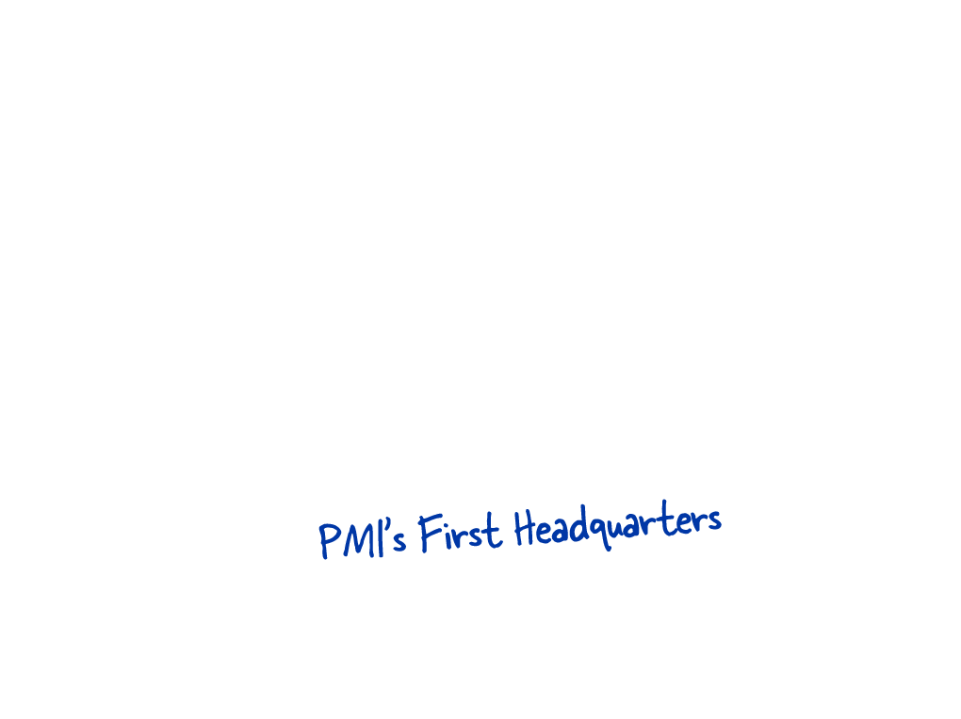


Slide 5


Slide 6

1997
31,333 Total Members. 6,119 Certification Holders Representing 96 Countries
95% Membership
93% PMPs
4% Membership
3% PMPs
0.75% Membership
0.5% PMPs
0.25% Membership
3.5% PMPs
Notes:
In 1997, this is what our membership looked like. Notice that North America dominated in membership and credential holders.

Slide 7
February 2016
478,493 Total Members. 694,000+ Certification Holders
in Nearly Every Country in the World
60.1% Membership
47.7% PMPs
15% Membership
13.6% PMPs
6.9% Membership
5.0% PMPs
18% Membership
34% PMPs
Notes:
Need updated numbers
This has changed dramatically since then. Today we serve almost a million practitioners in nearly every country (185 countries) on the globe. Internationally, we’re seeing consistent growth.
That requires us to think about serving those in these different locations……or in different stages of their professional career……or simply just the way they personally want to be served.

Slide 8
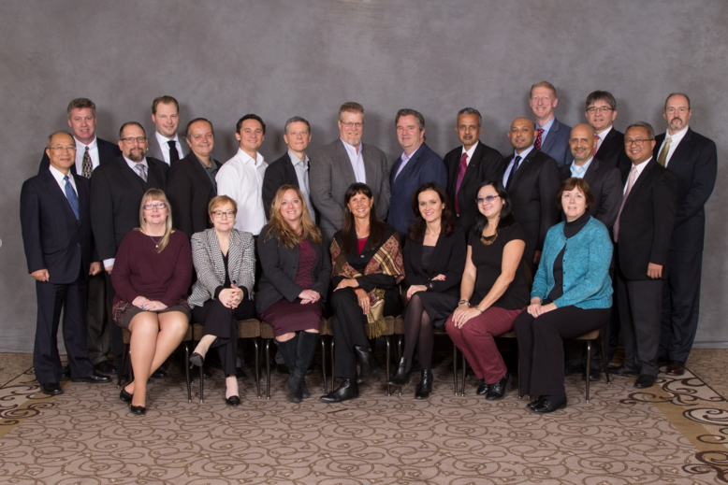
LIVPM Jan 2016

Slide 9
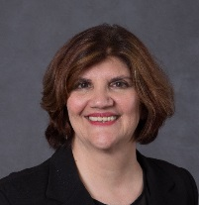
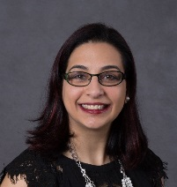
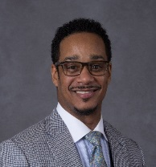
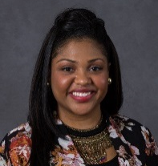


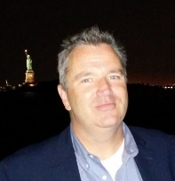
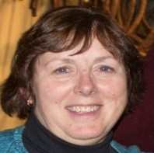

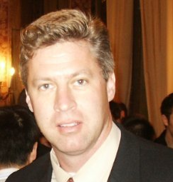
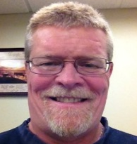
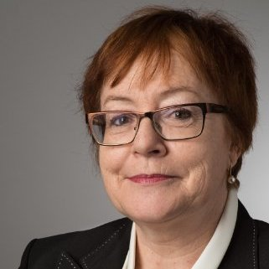
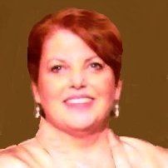
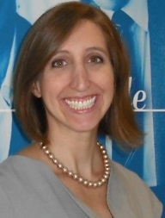

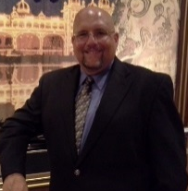

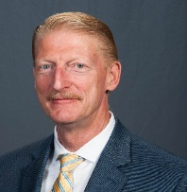
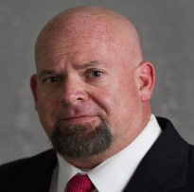

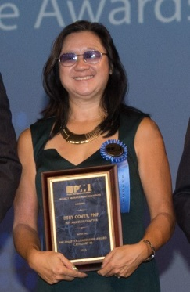
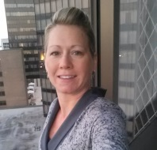
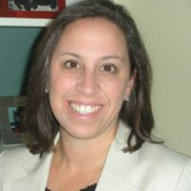
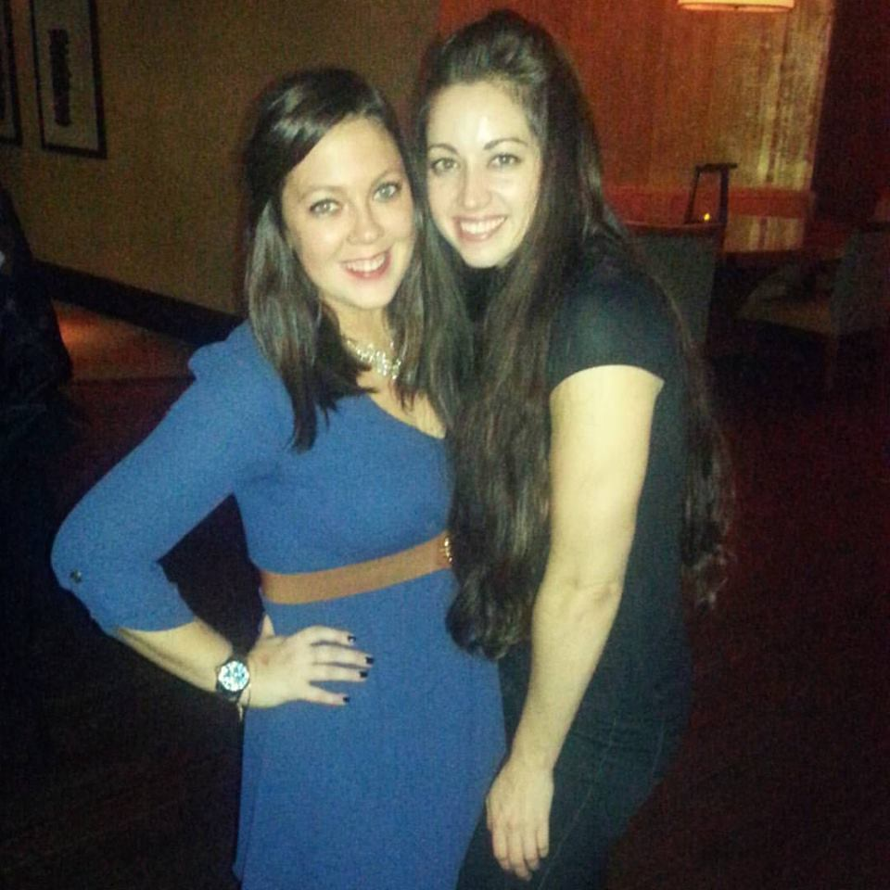
North America
Region 4
Northern US
Region 1
NW US & West CA
Region 2
NC US & C. CA
Region 3
Far NE & E. CA
Region 14
SE US & Carib.
Region 5
Mid-Atlantic US
Region 6
Midwest US
Region 7
Southwest US
Region 6
Notes:
The Project Management Institute has mapped the world-wide local chapters into sixteen regions and that is supported by 21 Region Mentors.
Shown here is a representation of how North America is divided up.
Region 1: Northwest US and Western Canada
Region 2: Northcentral US and Central Canada
Region 3: Eastern Canada, ME, , MA, RI & CT
Region 4: Northern US – MI, OH, PA, NY, NJ
Region 5: Mid-Atlantic States
Region 6: Midwest US
Region 7: Southwest US
Region 14: Southeast & Caribbean Islands

Slide 10
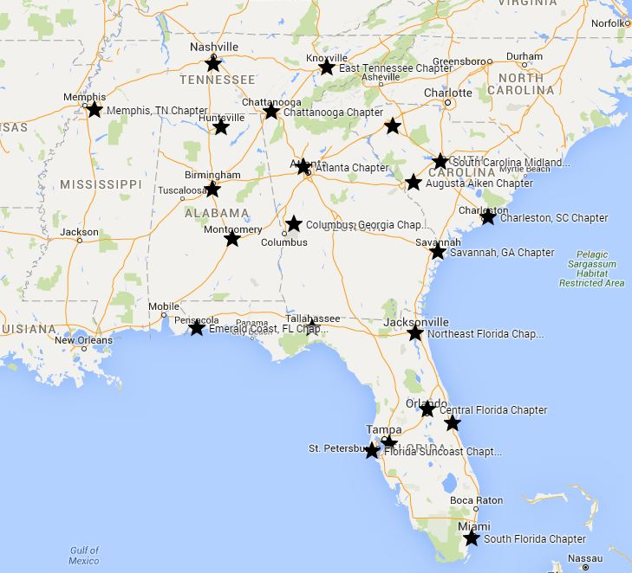



Slide 11
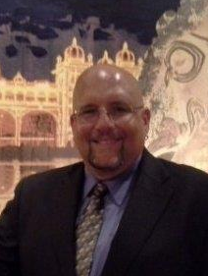


Region 14 – 24 Chapters across Southeast NA and Caribbean
James Devine
Current Mentor
Joseph Paschall
Shadow Mentor
Mary Keller
Chapter Partner
Sarah Maxwell
Chapter Administrator
Notes:
Region 14 has three main roles to support the 24 chapters within the Region. We have the Region Mentor (Me), the Chapter Partner (Mary) and the Chapter Administrator (Sarah).
So what is a Region Mentor and what does he do? To start, the mentor position is a volunteer position. An individual can apply for a Region Mentor position, but must meet some minimum experience rqmts such as having served in a Senior level Chapter Leadership role. You apply through the VRMS. The assignment is a 3-4 year term. The first year is that of a Region Mentor shadow, the 2nd & 3rd years are acting as the Region Mentor and the 4th year is an optional year.
Encourage networking and facilitate collaboration among chapter leadership
Support chapter leadership in strategic, operational, and transition planning
Provide advice, information and coaching to chapter leadership
Lead the planning and implementation of annual region meeting
Provide advice, information and support to PMI staff
Chapter Administrator:
Facilitate PMI chapter formation and reorganization processes
Help with renewing charter or maintaining your chapter
Review bylaws/governing documents
Administers electronic elections, taxes, and insurance
Assistance with online community sites and Component System (CS)
Support the planning and implementation of annual region meeting
Chapter Partner:
Provide support for annual chapter operation planning and execution
Evaluate results to drive new and/or improved plans
Maintain ongoing partnerships with chapters to ensure their annual success
Assistance with online community sites and Component System (CS)
Support the planning and implementation of annual region meeting

Slide 12
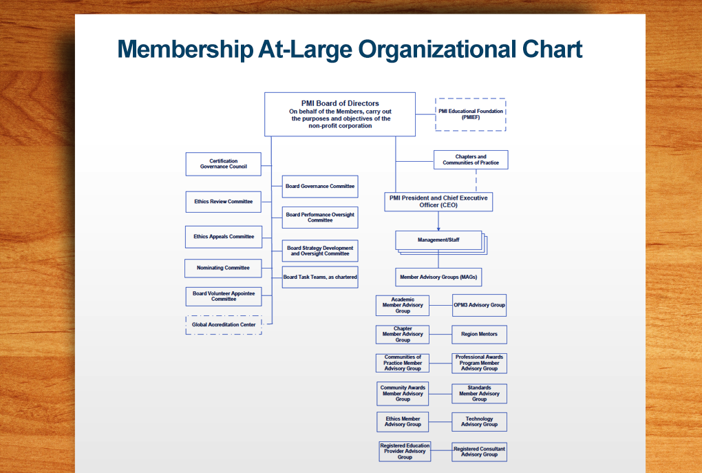
Notes:
PMI is largely a volunteer organization and is governed by a volunteer Board of Directors, comprised of 15 member-elected directors who serve three-year terms. Three directors, who are elected by others on the Board each year, serve as officers of the Institute. Volunteer are involved at PMIEF, the Chapters, CoP and Member Advisory groups where my position falls under – Again all volunteers. However, we do have paid staff to assist us in our volunteer roles. Let’s take a deeper look into how PMI divides up the global organization.
The collective wisdom, experience, diversity and passion of the Board ultimately sets and executes PMI’s core ideology: our core purpose — PMI’s reasons for being, and our core values — the essential and enduring principles that guide PMI. Our vitality and relevance is driven by the PMI Board and its volunteers.
PMI Board of Directors – 15 Volunteers
Over 30 CoP

Slide 13
PMI Board Support
Board Volunteer Advisory Committee
Certification Governance Committee Council
Ethics Review Committee
Global Accreditation Center for PM Education Programs
Nominating Committee

Slide 14
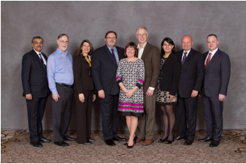
Board Volunteer Advisory Committee
Acts on behalf of the PMI Board of Directors to evaluate and recommend members to serve on the Board Support Committees
Comprised of former RMs, and Chapter Board Members
9 Elected Members, 3 yr terms
Attend LIVPM, and other activities as requested and available

Slide 15
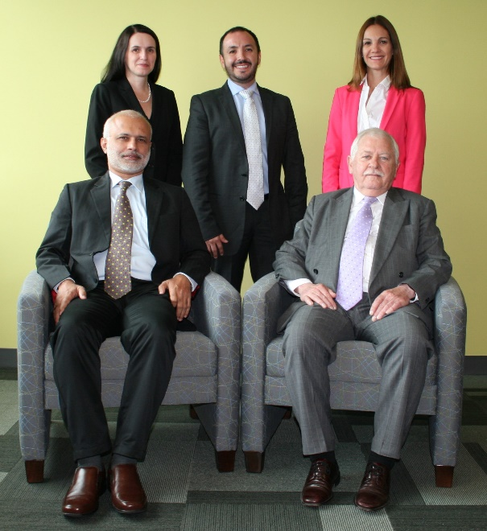
Nominating Committee
Oversee and supervise the nominating process for PMI Board of Directors positions
Comprised of personnel with executive interviewing experience
5 Elected Members of different regions
Attend LIVPM, potential other travel for interviews, and teleconferences

Slide 16
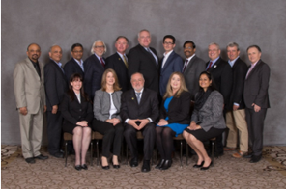
Ethics Review Committee (ERC)
Investigate and resolve ethics complaints related to violations of the PMI Code of Ethics that have been filed against PMI members & other individuals…
Comprised of volunteers
6 members, staggered 3 year terms, option to apply for additional term
Attend LIVPM, LIM, and mid-year ERC Planning Meeting

Slide 17
Member Advisory Groups (MAGs)
Academic Member Advisory Group
Chapter Member Advisory Group
Ethics Member Advisory Group
OPM Advisory Group
Professional Awards Member Advisory Group
Registered Consultant Advisory Group
Registered Education Provider Advisory Group
Social Media Advisory Group Charter
Standards Member Advisory Group
Technology Member Advisory Group

Slide 18
Academic Member Advisory Group
Work in partnership with PMI Academic Resources staff to provide expert support for and recommendations regarding the array of programs and services…
No former volunteer experience required; Academic faculty/researchers distributed across gender, academic discipline, field, industry and professional role, and PMI geographic region
10 members, staggered 2 year terms, option to apply for additional term
Attend LIVPM (optional) and mid-year AMAG Planning Meeting

Slide 19
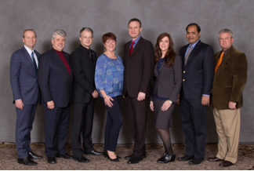
Chapter Member Advisory Group (CMAG)
Provide feedback to ensure that PMI delivers value to our chapters and their volunteers… add value to chapter volunteer programs and act as a vehicle between PMI and its chapters.
Comprised of former RMs, Chapter Board Members, and others with previous volunteer experience
8 members, staggered two year terms, option to apply for additional term
Attend LIVPM, LIM, and mid-year CMAG

Slide 20
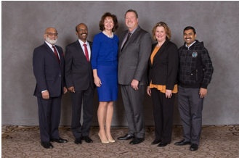
Professional Awards Member Advisory Group
Assist with the creation, direction, monitoring, and evaluation of the PMI Professional Awards Program
Comprised of former RMs, and Chapter Board Members
6 members, staggered 2 year terms, option to apply for additional term
Attend LIVPM, LIM, and mid-year AMAG Planning Meeting

Slide 21
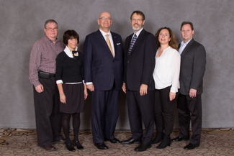
Standards Member Advisory Group
Advise the PMI Standards Manager in the development of PMI standards
No previous leadership experience; PMI member for 2 years
6 members, staggered 2 year terms, option to apply for additional term
Attend LIVPM, LIM, and mid-year SMAG Planning Meeting

Slide 22
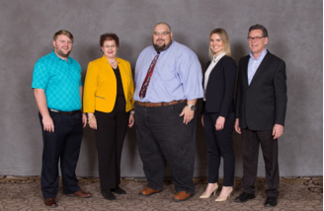
Social Media Advisory (SMAG)
Work in partnership with PMI’s brand management staff to provide analysis and recommendations related to the current and future state of PMI’s social media strategy
No volunteer experience required; social media experience
5 members, staggered 2 year terms, option to apply for additional term
Attend LIVPM, LIM, and mid-year SMAG Planning Meeting

Slide 23
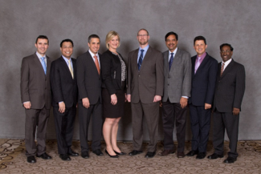
Technology Advisory Group (Tech MAG)
Work in partnership with PMI IT staff and serve as subject matter experts and provide guidance and recommendations on the conceptualization, and planning of the information technology strategy
Comprised of technologists with no requirements for previous PMI leadership roles
8 members, staggered 2 year terms, option to apply for additional term
Attend LIVPM and LIM

Slide 24
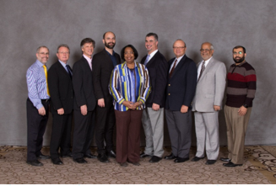
REP Advisory (REP AG)
To support PMI R.E.P. Program staff in the execution of their operational responsibilities and accountabilities through advice, counsel, and direct participation …
No previous volunteer experience required; professional work experience considered
7-10 globally distributed members, no term limits
Attend LIVPM, and LIM

Slide 25
Other Volunteer Opportunities
Exam Development Volunteers
PMI seeks volunteers to participate in exam development workshops conducted at least once a year in each of the four geographical regions. Participants are randomly selected based on specific selection criteria such as geographic area, years certified, industry and member status.
PMI Awards Evaluators
PMI awards evaluators are virtual volunteers whose commitment makes the PMI professional awards program possible. Volunteers from around the globe represent the world of organizations that rely on project management for success.

Slide 26

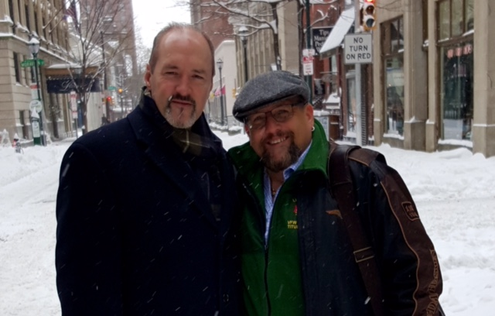
PMI Upcoming Events
PMI North America
  PMI Leadership Institute Meeting 2016, San Diego CA – 9/22-24
  PMI Global Congress 2016 – San Diego, CA 9/24-26
  PMI LIVPM 2017 – Philadelphia, PA 01/17
What is PMI? I am PMI!
Notes:
is an opportunity for learning, sharing and networking with your fellow community leaders and PMI staff. You’ll benefit from informative workshops on building and maintaining successful communities, improving volunteer engagement, succession, transition and on-boarding strategies; and much more. We look forward to having your chapter represented at the North America Leadership Institute Meeting (LIM)!

Slide 27
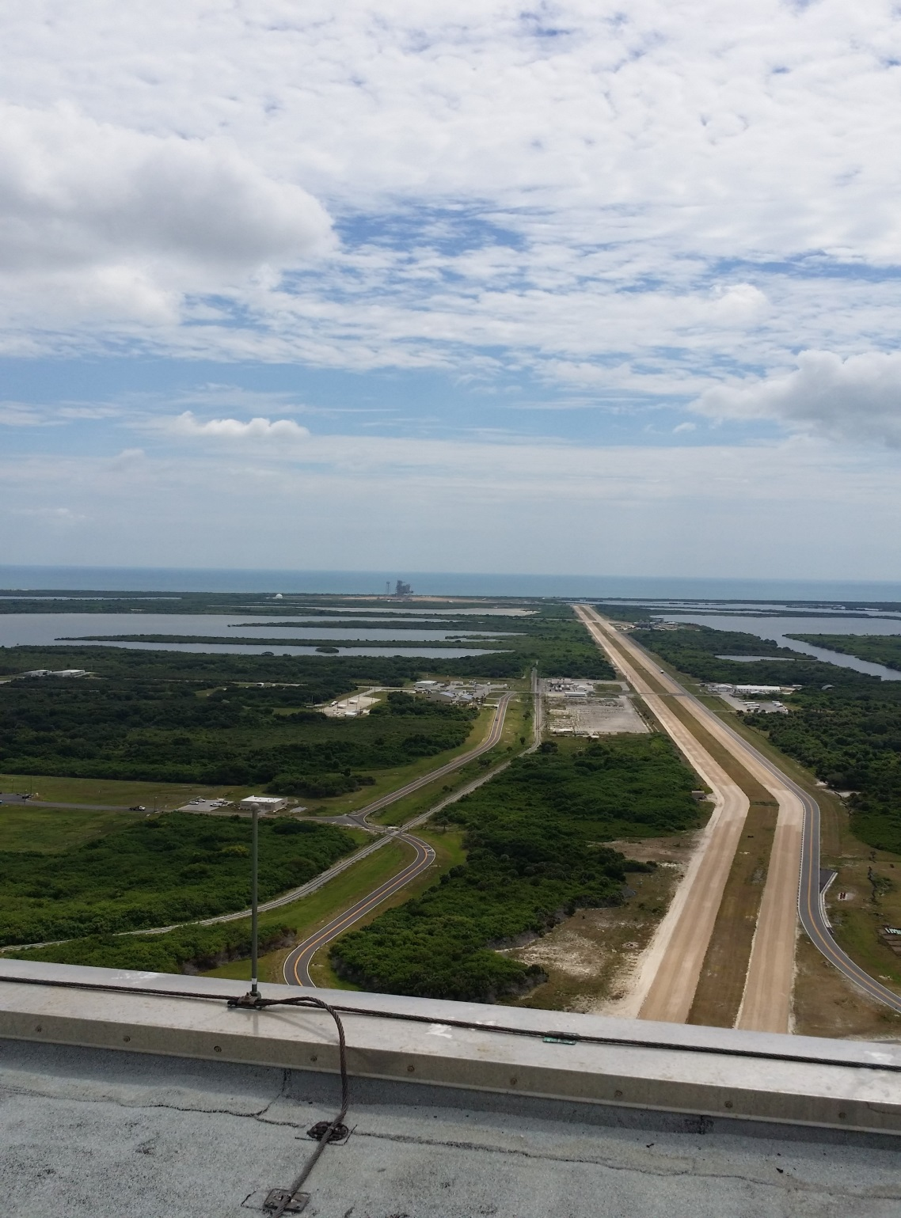
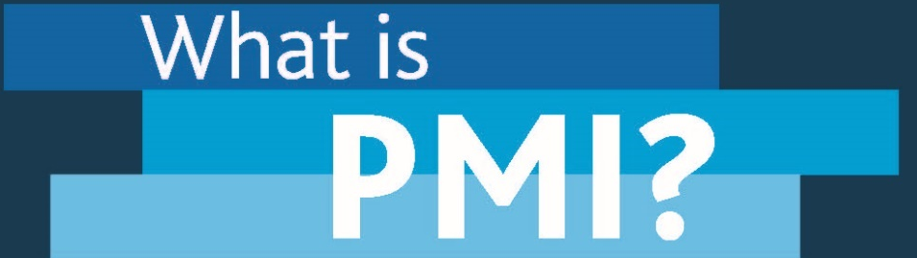

Q&A
Contact:
James.Devine@mentor.pmi.org Joseph.Paschall@mentor.pmi.org

